Slide 1
Mr. Raw’s story PPIT team RAW
From Rags to Riches... Based on a true story

Slide 2

Story of new NSCC student, Mr. Raw
80%
95%
65%
50%
35%
Stutus Quo
- Social Anxiety
Lack of Mental and Physical Energy
- No idea about career
OvercomeMental Roadblock
Read Dare to Lead​
Physical Strength
Career Market Analysis
Intelligence Officer

Slide 3
THE MENTAL ROADBLOCK
Tristen McIsaac

Slide 4
Raw's Experience With Anxiety
Mr. Raw suffered from social anxiety throughout most of his life. He hardly ever spoke to his friends or family and he was often bullied in the past when he was younger because of his shyness. He hardly ever leaves his house out of fear of embarrassment, his shyness, and his tendency to compulsively worry.
The negative practices of his anxiety caused his social integrity and confidence to drain significantly to the point where it really began to impact the outlook of his future dream career of wanting to become a professional intelligence officer.
Raw was starting to become deeply concerned about the possibility of making his dream become a reality as he was having extreme difficulty mustering confidence
and willpower because of his anxiety, and deep down he knew that he needed to find a solution or else he'd risk being stuck in a socially isolated and negative lifestyle.

Slide 5
A Solution
One day, Mr. Raw decided to sit down and take some time to really think about how he could tackle the effects of his social anxiety.
He knew that it would require him to push outside of his introverted bubble, and although it would be a hard challenge to overcome for him, it was something that needed to be done.
In time, did some of his own research into well-known coping strategies and decided that the following would be the simplest yet most effective:
- Peer talk sessions with friends and family
- Practicing humour in conversations
- Self-Meditation Sessions.
- Sound therapy such as white noise and music.
- Daily routine exercise.
- Forming a healthy nutrition plan.
- Mental visualization.
- Breathing regulation when under stress.

Slide 6
Read Dare to Lead
Erin Sellers

Slide 7

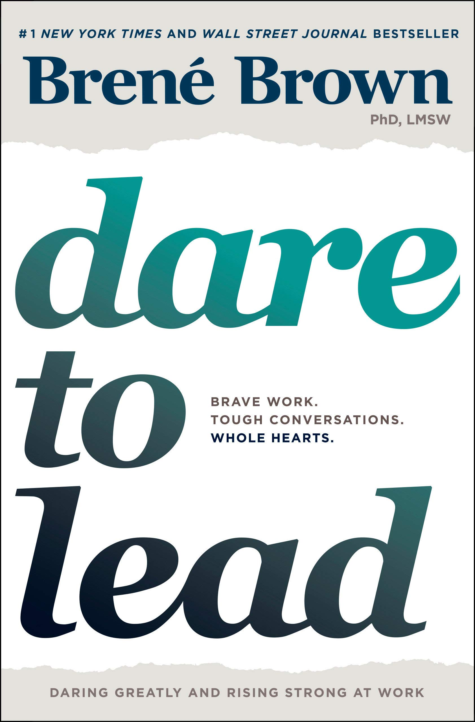
Who is
Brené Brown?
Wilson, M. (n.d.). Image of Brené Brown. [image] Available at: https://www.google.com/url?sa=i&rct=j&q=&esrc=s&source=images&cd=&ved=2ahUKEwi85rOF-OTlAhWkc98KHbfiCNIQjRx6BAgBEAQ&url=https%3A%2F%2Fwww.amazon.ca%2FDare-Lead-Brave-Conversations-Hearts%2Fdp%2F0399592520&psig=AOvVaw2WdsrKoQn8HJDm26K13nAR&ust=1573657199826832 [Accessed 12 Nov. 2019].
Notes:
Dr. Brené Brown is a research professor at the University of Houston where she holds the Huffington Foundation – Brené Brown Endowed Chair at The Graduate College of Social Work.
She has spent the past two decades studying courage, vulnerability, shame, and empathy and is the author of five #1 New York Times bestsellers: The Gifts of Imperfection, Daring Greatly, Rising Strong, Braving the Wilderness, and her latest book, Dare to Lead, which is the culmination of a seven-year study on courage and leadership.
Brené’s TED talk – The Power of Vulnerability – is one of the top five most viewed TED talks in the world with over 35 million views. She is also the first researcher to have a filmed talk on Netflix. The Call to Courage special debuted on the streaming service on April 19, 2019.
Brené lives in Houston, Texas with her husband, Steve. They have two children, Ellen and Charlie.

Slide 8
menti.com

Slide 9

Learning to Rise
01
The Revolution
Claim authorship of your own stories.
02
The Rumble
Stepping into the story and owning it.
03
The Reckoning
Acknowledging the situation and naming the emotions you're feeling.
Notes:
-The reckoning is acknowledging the situation and naming the emotions you’re feeling. This means taking responsibility rather than blaming others or getting mad.
-The rumble is stepping into the story and owning it. We often make up stories about what is happening, where other people are the villains. It’s important to acknowledge that this is made up and recognize the real story.
-The revolution, this is where you claim authorship of your own stories. It’s taking off the armour and rumbling with vulnerability, living into our values, braving trust with open hearts and learning to rise.

Slide 10
Physical Strength
Cheolsoon Im

Slide 11
Do you know?
01
How much push-ups Mr. Raw did on 25 Oct 2019?
1) 100 2) 200 3) 300 4) 0
02
How much crunches Mr. Raw did on 12 Oct 2019?
1) 100 2) 200 3) 300 4) 0
03
What is the most difficult challenge he has for his workout?
1) He doesn’t know how to do pushups 2) Lots of other things to do 3) His children want to play with him 3) He hates to do pushups.

Slide 12
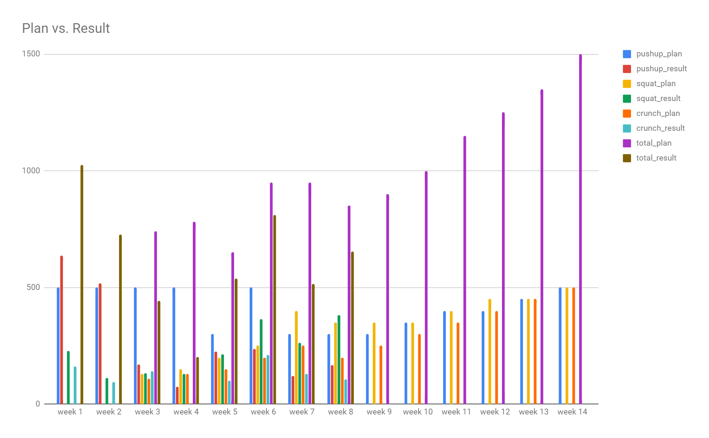
Physical Strength!
Text
Text
What he did
- Set up a plan
- Exercised almost every day
- Recorded daily journal
Key Takeaway
- Hard to maintain the pace of workout
- Keep adjusting your goal.
- Never give up.

Slide 13
Career Market Analysis
Blossy Figer

Slide 14
To become a professional in IT field I have decided to do a diploma in IT Data Analytics. Which will eventually help me to acquire skill sets require to become a successful professional in this field​
So, I have decided to do a market research on IT career and discover what jobs are available in the market, what skills are required to be a professional in this field and what are the immigration barriers
Below are some skill sets​:
Ability to analyze and interpret data​
Problem-Solving skills​
Should know Programming languages, such as Python, SQL, R, Oracle​,Java
A logical approach​
The ability to plan work and meet deadlines​
Attention to details and accuracy​
Interpersonal & team working skills​
Written and verbal communication skills​
​
Market research on IT Career

Slide 15
Job Title
I searched different online job portals and identified what all jobs are available for IT Data professionals. Below are some designations for which I would love to work
IT Data Analyst​
Business Analyst​
BI Analyst​
Data Architect​
Data Analytics Specialist​
Intelligence Officer​

Slide 16
Feasibility to work & live in NS
Immigration​​
I came to Canada as an international student so to work and stay here I either need a work permit, Permanent Residency or I must be a Citizen of this country
Once I finish my study here, I am planning to apply for permanent Residency as to stay and work in Canada​​
​
Average Salary​​
Average salary for Data Analyst in Halifax region would be around $45,000 to $50,000​​
Work Life Balance
I can balance my professional and personal life while living in Halifax
Halifax offers excellent housing options cost of living is low as compared to other provinces
​​

Slide 17
1. What are some important skills required to become an analyst?
Ability to analyze and interpret data
Problem-Solving skills
Should know Programming languages, such as Python, SQL, R, Oracle ,Java
A logical approach
The ability to plan work and meet deadlines
Attention to details and accuracy
Interpersonal & team working skills
Written and verbal communication skills
2.Which are the 3 ways through which an International student can work and stay in Canada?
Work permit
Permanent residency
Become a Canadian citizen
3.What is the average salary for Data Analyst in Halifax area?
Average salary for Data Analyst in Halifax region would be around $45,000 to $50,000

Slide 18
Intelligence Officer
Gurleen Kaur

Slide 19
Intelligence Agency
There are 195 countries in the world. Each country has its own intelligence agency which is a government agency responsible for the collection, analysis, and exploitation of information in support of law enforcement, national security, military, and foreign policy objectives. Means of information gathering are both overt and covert and may include spying, communication interception, cryptanalysis, cooperation with other institutions, and evaluation of public sources.
(n.d.). Retrieved from https://en.wikipedia.org/wiki/Intelligence_agency.

Slide 20
Intelligence Officer
An intelligence officer is a person employed by an organization to collect, compile or analyze information which is of use to that organization. Organizations which employ intelligence officers include armed forces, police, and custom agencies. The role and intelligence officer varies depending on the orbit of its parent organization. Titles and responsibilities among intelligence officers include Field officer, Case officer, Collections officer, Operations officer, Analyst, Counterintelligence officer. Mr. Raw wants to be an analyst, who analyzes collected information and results of operations to determine identities, capabilities and activities of hostile individuals or group.
(n.d.). Retrieved from https://en.wikipedia.org/wiki/Intelligence_officer.

Slide 21

What is the chief intelligence agency for...
… India?
A) Defence Intelligence and Security Service (DISS)
B) Intelligence Bureau (IB)
C) Ministry of State Security (MSS)
D) Subsidiary Intelligence Bureau (SIB)
… Israel?
A) CSIS
B) Mossad
C) Central Intelligence Agency (CIA)
D) Foreign Intelligence Service (SVR)
… Pakistan?
A) State Security Service (VSSE)
B) IBLMV
C) Directorate-General for External Security (DGSE)
D) Inter-Services Intelligence (ISI)
… Iraq?
A) ASIS
B) Intelligence Bureau
C) Mukhabarat
D) Federal Intelligence Service (BND)
… South Korea?
A) The National Intelligence Service (NIS)
B) Ministry of State Security (MSS)
C) ASIS
D) Research and Analysis Wing (RAW)
… Afghanistan?
A) Research and Analysis Wing (RAW)
B) Khad (State Intelligence Agency)
C) Communications Security Establishment (CSE)
D) Badan Intelijen Negara (BIN)

Slide 22





Conclusion
Physical activity
Overcoming anxiety
Implementing the decision
Mental Strength
Physical Strength
Intelligent Goal E
Leading by Reading
Market
Analysis
Leadership
Selecting a career path

